Slide 1
Being a successful student
Being a successful student will mean different things to different people. For some of you it will be to achieve high grades, others will want to get onto the right course for their chosen career path and for some it will be surviving the next two years. Whatever your goal is there are ways in which you can help yourself

Slide 2
There is no one size fits all answer in how to be a successful student, but everyone needs to start somewhere.
There will be moments of difficulty and there will be moments of success. Use these moments and learn from them
Watch the talk from Michelle Obama and the importance she places on education and overcoming the obstacles that will be placed in your way
Notes:
Click on the picture to gain access to the speech. 11 mins 33 secs

Slide 3
What obstacles do you have?
Time management?
Working with others?
Meeting deadlines?
Believing in yourself?
This session is about giving you tips and advice on how to overcome some of your obstacles
Notes:
Quick discussion on how these can be a problem

Slide 4
How good is your time management?
How often do you find yourself running out of time?
When you know how to manage your time you can gain control.
Watch the following TED talk from Laura Vanderkam ‘How to gain control of your free time’.
What would you put into each of the three category lists?
How is the TED talk relevant to being successful in sixth form?
Notes:
Click on logo to get access to the TED talk video. 11 mins 46 secs

Slide 5
The Importance of time management and failure to use time…
Work out of control, behind on assignments
Total paralysis, cant get started with studies
Inefficient study, long hours but little effect
Procrastination
The advantages of good time management
Increased effectiveness
Increased efficiency/Saves time
Prevents stress/Reduces anxiety
Motivates and initiates
Reduces avoidance of tasks
Allows review and reflection
Eliminates cramming
A more balanced life

Slide 6
Other Time Management Tools
Know your strengths and weaknesses
Know what is required of you
Work with your natural body rhythms and patterns
Allow for the unexpected
Think of yourself as ‘high powered worker’, (the average full time workload is 40 hours a week, transfer this to your weeks plan)
Allot particular hour blocks for particular tasks
Plan your reading time
Set realistic goals and meet them
Manage your work space as well as your time
Draw up a time management plan.

Slide 7
How to stay motivated
Watch this short video. Is there anything else you could suggest that helps to defeat the feeling of a lack of motivation?
How to Make Yourself Study When You Have ZERO Motivation
What will be the your steps to staying motivated?
Do you think any of the tips in the video would help you?
Notes:
Click on the link you only need to watch the first 5 mins

Slide 8
Start to really look after yourself
Nutrition and hydration: what are you eating, when are you eating? If you want to optimise your performance you have to think about how you are fuelling yourself.
Make a list of what you have eaten and drunk over the last 24 hours. (Be honest!). Are there any switches you could make to ensure that you are eating less sugar, less refined carbs? Have you drunk enough water?
Exercise: You don’t have to go near a gym or run a marathon – just build in a walk or a swim everyday. Something for you.
Have a look at the ideas on the PiXL student website under POWER TO PERFORM
Notes:
Lots of materials in the Power to perform folder on the website that you can use with the students.

Slide 9
Controlling stress
Some of us get more stressed than others…but we’ll all feel some stress in the next few months. So, some tips for dealing with it!
Remember that it’s perfectly normal to get stressed. If it feels like it’s too much to deal with, talk to a friend, parents, teacher. SHARE!
Be kind to yourself: have quiet times when you can relax. Try something like mindfulness. There are lots of websites where you can find out more, such as www.mindful.org.
Eat properly – don’t fill up on sugary food that will result in a quick drop of energy and make you feel rubbish!
Sleep!
Notes:
Please do discuss these – you’ll be able to think of lots more techniques, these are just a few.

Slide 10
Sleep…. Zzzzzz.
Essential: studies show that sleep mends your body and makes you in to a better learner.
What time do you normally go to sleep? Are you sleeping for long enough?
Are you winding down in the hour before you go to sleep?
E.g. stopping work, turning screens / devices off?
Talking of screens and devices….
Notes:
This may be a useful video to watch if you have time and bear in mind that many references are American.

Slide 11
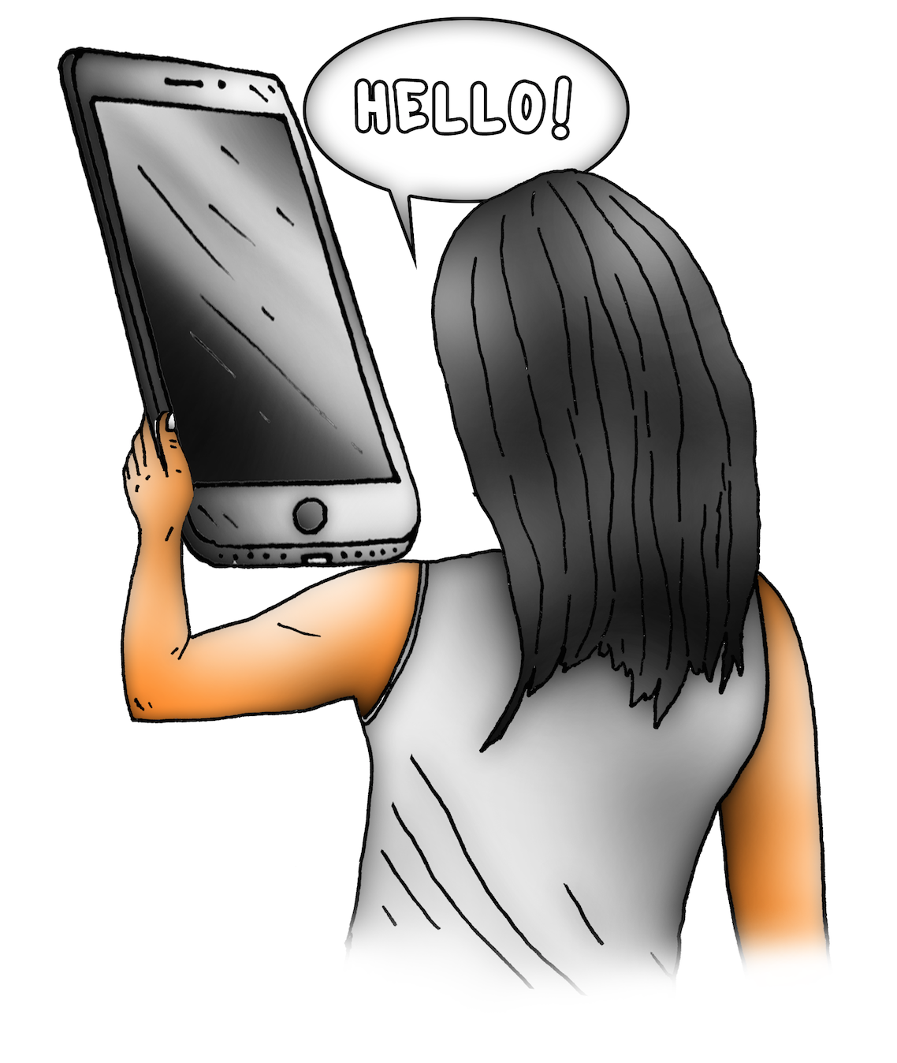
The power of THE PHONE to stop you working (and sleeping and talking and living in the real world….)
Does this seem familiar to you?
Tech Control
Be honest – how much time do you spend on your ‘phone? Is it a distraction when you’re supposed to be working?
Notes:
Please discuss the content of the video – how many of these things do your students do – AND what impact is it having on their learning / sleep / relationships etc..

Slide 12
What steps could you take to become a successful student?
These do not need to be big changes, as starting with small, more realistic changes will help you more in the end
Write a letter to yourself for the end of year 13, write down the things you hope you will achieve and the positive changes you hope to make

