Slide 1
YEAR 11
Weekly Intervention
See your teacher about extra support sessions.
All sessions are after school unless otherwise stated.
Together towards our Lord, through learning, love and faith

Slide 2
MONDAY
ART | ART Block Ms Farnham & Mr Petrie in A1 and A3
BUSINESS | Maryvale House Ms Begum in G2
DRAMA | Drama Block Ms Keane in DR1 (PRACTICAL)
ENGINEERING | In room T9
GEOGRAPHY | Main Block Mr Cunningham in room 18
HEALTH & SOCIAL CARE | Littlemore House Ms Burns in B5
HISTORY | Ms Thoulass in Room 24
Together towards our Lord, through learning, love and faith

Slide 3
MONDAY
MFL | MFL Block See Ms Conway in N1
RE | Littlemore House See your RE teacher for details or see Mr Makokha in B11
SCIENCE | Science Block Biology S3 Combined Science (Foundation) S10
STUDY CLUB | iBlock See Mr Kirby and Ms McSweeney i4
TEXTILES | Art Block See Ms Kravcova in room A2
Together towards our Lord, through learning, love and faith

Slide 4
TUESDAY
BUSINESS | Maryvale House Ms Chappell in G5
ENGLISH | Main Block See your English Teacher
GEOGRAPHY | Main Block See Ms Archer in room 17
HEALTH & SOCIAL CARE | Littlemore House See Ms Burns in B5
MATHS | Main Block Foundation in room 16 Higher in room 15
SCIENCE | Science Block Combined Science (Higher) in S6 Combined Science (Foundation) in S5 Triple Science in S9 Required Practicals in S8
Together towards our Lord, through learning, love and faith

Slide 5
WEDNESDAY
ART & TEXTILES | Art Block Rooms A1, A2 and A3
BUSINESS | Maryvale House G6,
DRAMA (Written) | Drama Block DR1
ENGINEERING | Room T9
FOOD | Science Block Room T2
GRAPHICS | Main Block Room R2
GEOGRAPHY | Main Block, Room 19 with Ms Chauchan,
Together towards our Lord, through learning, love and faith

Slide 6
WEDNESDAY
HEALTH & SOCIAL CARE | Littlemore House Room B5, Ms Burns.
ENGLISH | Main Block See your teacher
HISTORY | Main Block 07:30 Room 21, Ms Keane 15:00 Room 23, Ms Welch
PE | Sports Hall See Mr Brooks
MATHS | Main Block Foundation Maths in Room 12
SCIENCE | Science Block Combined Science (Higher) in room S6 Triple Science in S2
Together towards our Lord, through learning, love and faith

Slide 7
THURSDAY
MEDIA STUDIES | C1 SEE MS FRASER
LIMITED SESSIONS DUE TO STAFF TRAINING EACH THURSDAY
FRIDAY
DRAMA (Practical) | Drama Block DR1, Ms Keane
MATHS | Main Block Room 10, Higher with Mr Paparam
RE | Ask your RE teacher for details or see Mr Makokha in B11
Please see your teacher to ask for when sessions are for:
- Computer Science
- Music

Slide 8
REVISION ADVICE
Do!
Do plan your revision materials ahead of time –Separate topics into clearly divided sections and reduce long essays into bitesize notes for easier learning. Practice mathematical equations regularly. Separate subject revision into clear time slots and stick to the time.
Do test yourself – Write and re-write your notes from memory to ensure facts are stored in your brain in the long-term. Practice mathematical equations and science end of topic sections. Ask a parent or friend to create short quizzes for you to complete.
Do start early – It is scientifically proven that our brains are more energized and active in the mornings. Wake up in good time and be ready to start revising. Finish in the evenings in good time so that you can relax and allow all the revision to sink in! A good night’s sleep will also ensure you awake feeling refreshed for the day of revising ahead.
Don’t
Don’t keep putting off work – Put away your mobile phone, iPad, laptop and anything else that is a distraction! Plan when your are studying and when you are seeing friends and family. Revision/ study is best done daily to ensure your brain retains all the information and all the facts you’ve been learning.
Don’t work in a noisy place – Find a nice quiet room at home or in a local library where you can revise in peace and quiet.
Don’t feel defeated – You are not alone! All your peers are in the same situation. Share your revision techniques with your friends and stay positive. Allow your body and mind to rest when you’ve worked hard. And remember that once you’ve sat your exams, you’ll have plenty of time to relax! The longest summer holiday ever is on it’s way.

Slide 9
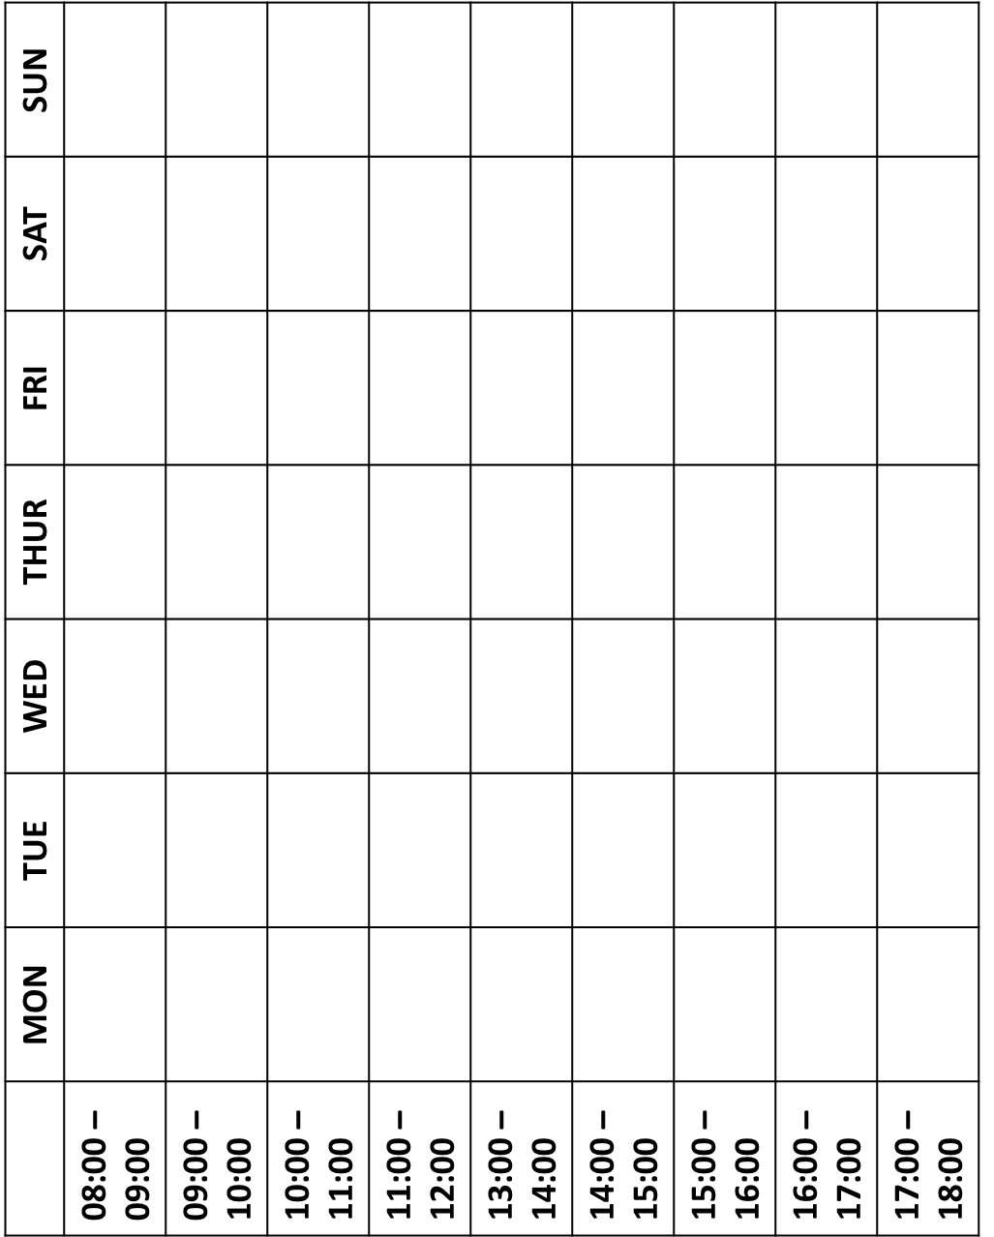
PLAN YOUR INDEPENDENT STUDY

Slide 10
PLAN YOUR INDEPENDENT STUDY

Slide 11
KEY STAFF CONTACTS
HEAD OF MATHS | MS STREATER sstreater@cardinalnewmanschool.net
HEAD OF ENGLISH | MR GARVEY ngarvey@cardinalnewmanschool.net
HEAD OF SCIENCE | MS RAZA araza@cardinalnewmanschool.net
HEAD OF RE | MR MAKOKHA lmakokha@cardinalnewmanschool.net
HEAD OF PE | MR BROOKS jbrooks@cardinalnewmanschool.net
HEAD OF ART AND DESIGN | MS BIGNELL kbignell@cardinalnewmanschool.net
HEAD of BUSINESS | MR HANIF yhanif@cardinalnewmanschool.net
HEAD OF COMPUTER SCIENCE | MR GOVENDER kgovender@cardinalnewmanschool.net
HEAD OF DRAMA | MS KEANE ckeane@cardinalnewmanschool.net
HEAD OF FOOD TECHNOLOGY | MS WINT swint@cardinalnewmanschool.net
HEAD OF HUMANITIES (GEOGRAPHY AND HISTORY) | MS THOULASS ethoulass@cardinalnewmanschool.net
HEAD OF MEDIA | MS FRASER hfraser@cardinalnewmanschool.net
HEAD OF MFL | MS CONWAY cconway@cardinalnewmanschool.net
HEAD OF MUSIC | MR CARTER scarter@cardinalnewmanschool.net
HEAD OF YEAR ASSISTANT HEAD OF YEAR | MR KIRBY tkirby@cardinalnewmanschool.net MS McSWEENEY smcsweeney@cardinalnewmanschool.net
CAREERS ADVISOR | MS McNEIL cmcneil@cardinalnewmanschool.net

Slide 12
CNS TOP REVISION TIPS
Together towards our Lord, through learning, love and faith

