Slide 1
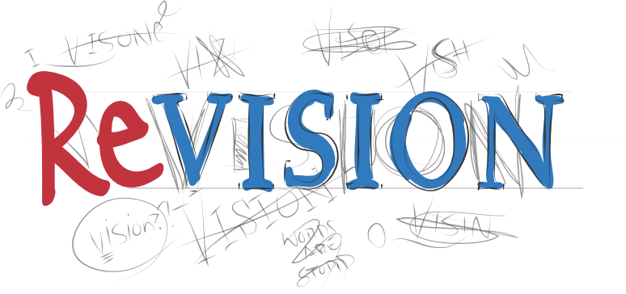

Slide 2
Exam Information (4:51 mins)
https://youtu.be/VSu9cKXIwHk

Slide 3
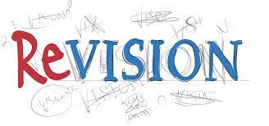
How to Revise Effectively
Not all revision strategies are equal. Some are far more effective than others. These proven strategies help students retain more information and increase their ability to recall them at a later date.
These techniques include:
retrieval practice
spacing
interleaving
pomodoro technique
Notes:
Impact of learning of teaching
Report back to students

Slide 4
What is Retrieval Practice?
The act of recalling learned information from memory.

Slide 5
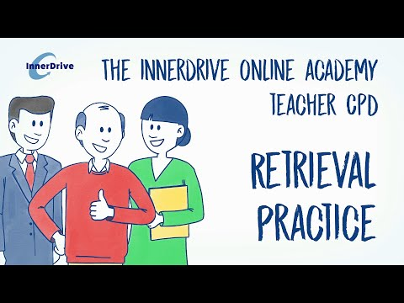
Retrieval Practice (1:52 mins)

Slide 6
Retrieval Practice

Slide 7
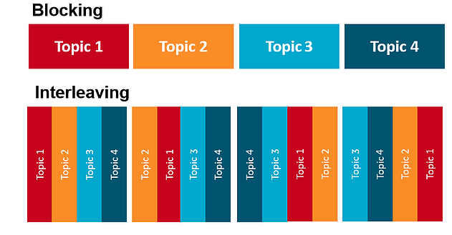
What is interleaving?
Interleaving involves mixing up subject or topics within the same subject when revising, the opposite of blocking (which is less effective).

Slide 8
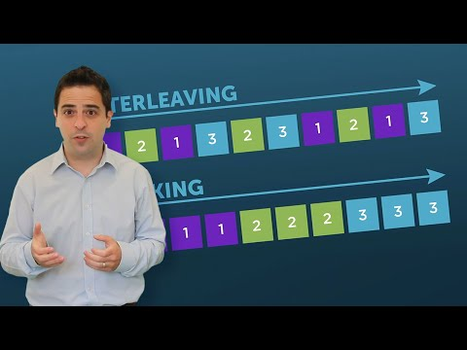
Interleaving (1:41 min)

Slide 9
Benefits of interleaving
Improved academic performance – students who used interleaving performed significantly better than those who revised using blocking.
Improved memory – As interleaving encourages students to make connections between topics, it can help strengthen their memory associations.
Improved processing skills– As interleaving encourages students to compare and contrast between different strategies, it can help them think about the process in more detail.
Notes:
Impact of learning of teaching
Report back to students

Slide 10
What is Spacing?
Spaced practice is when you break up your revision into a number of short sessions – over a longer period of time e.g. breaking up 4 hours of revision into eight 30 minute sessions.
Cramming
Spaced Practice
Notes:
Impact of learning of teaching
Report back to students

Slide 11
Spacing(1:42 mins)
Spacing, the act of revisiting material little and often, is one of the best learning strategies a student can use for memory retention
Notes:
Impact of learning of teaching
Report back to students

Slide 12
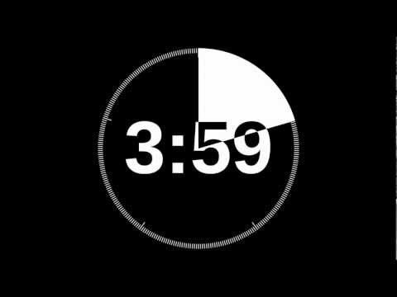
Mini Quiz
What is interleaving?
What is spacing?
Why is interleaving effective?
What is retrieval practice?
What is the benefit of retrieval practice?
Notes:
Impact of learning of teaching
Report back to students

Slide 13
Mini Quiz
Mixing up subject or topics within the same subject when studying.
When you break up your revision into a number of short sessions.
Improved memory, improved processing skills, improved academic performance.
The act of recalling learned information from memory.
Improves the transfer of knowledge, increases organisation of knowledge, creates stronger and deeper knowledge.
Notes:
Impact of learning of teaching
Report back to students

Slide 14
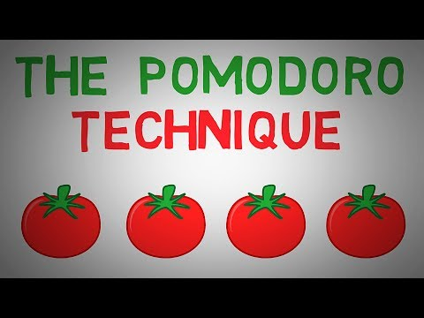
The Pomodoro Technique (5:46 mins) 🍅
The pomodoro technique is a time management method to reduce procrastination and increases revision focus.

Slide 15
The Pomodoro Technique 🍅
Notes:
Impact of learning of teaching
Report back to students

Slide 16
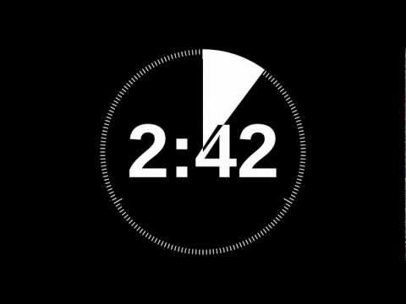
Mini Quiz
What does the word pomodoro mean?
What is the pomodoro technique?
In the pomodoro technique what is the guided amount of time for each study period (a pomodoro)?
What is the break time between each pomodoro?
After how many pomodoro should you take a longer break?
Notes:
Impact of learning of teaching
Report back to students

Slide 17
Mini Quiz
Tomato in Italian?
A time management method to reduce procrastination and increase revision focus.
25 minutes.
5 minutes.
4.
Notes:
Impact of learning of teaching
Report back to students

Slide 18
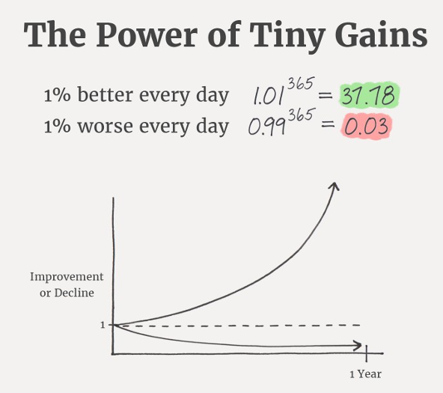
Revision Timetable - developing habits
A revision timetable helps you break down your revision into small achievable sessions alongside rest break and your social commitments.
The power of tiny gains - a 1% improvement everyday leads to being 37 times better after a year.
Notes:
Impact of learning of teaching
Report back to students

Slide 19
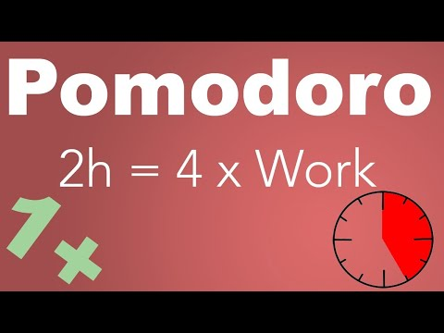
Revision Timetable - Developing Habits
Task: Produce a four week revision timetable using the pomodoro technique.
Enter your regular commitments such as sports training, clubs
Allocate times for breaks, dinner, and relaxing/down time
Decide which subjects to focus the most amount of you time on, generally your weakest subjects
Add the subjects you need to revise working backwards from the exams
Make the plan reasonable and achievable
Stick to your plan and the pomodoro technique to break down you revision into effective focussed sessions.
Tick off when you have completed a session - measure success in progress!!!
Notes:
Impact of learning of teaching
Report back to students

Slide 20
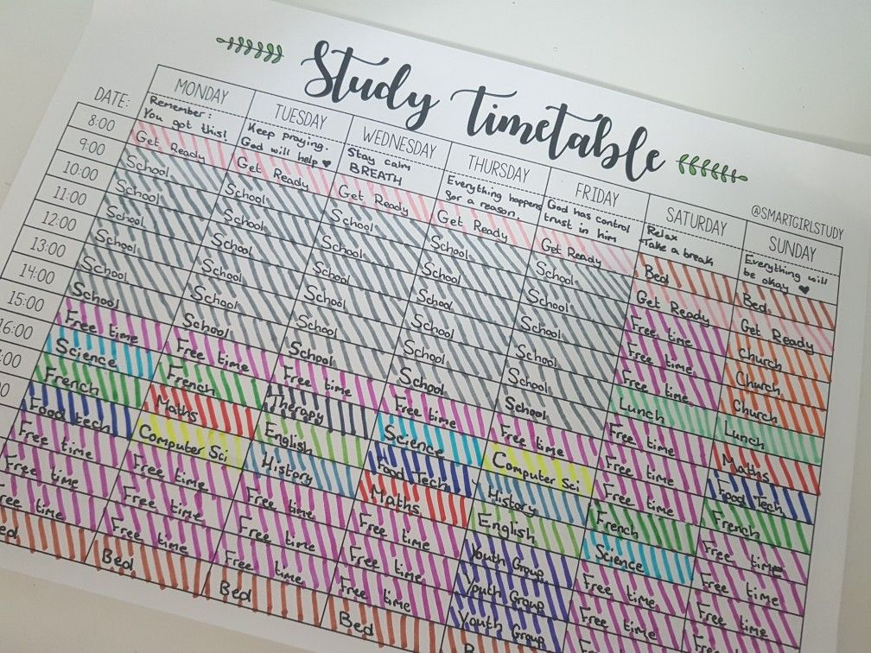
Revision Timetable - developing habits
Notes:
Impact of learning of teaching
Report back to students

Slide 21
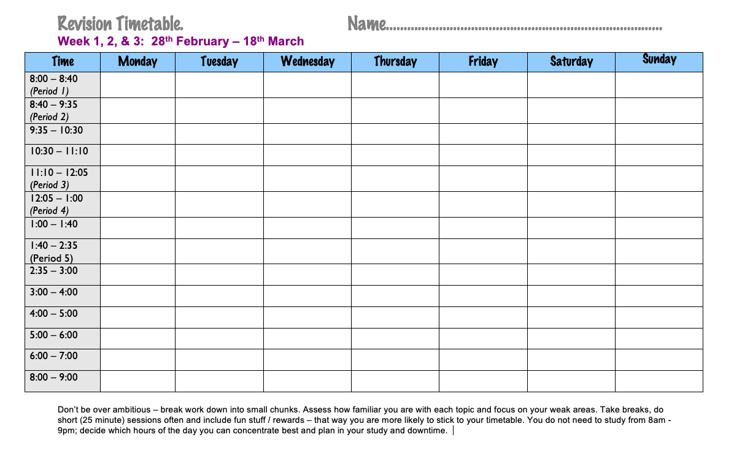
Notes:
Impact of learning of teaching
Report back to students

Slide 22
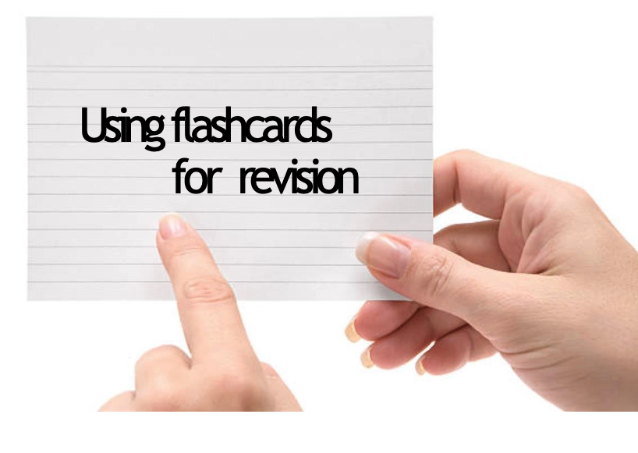
Notes:
Impact of learning of teaching
Report back to students

Slide 23
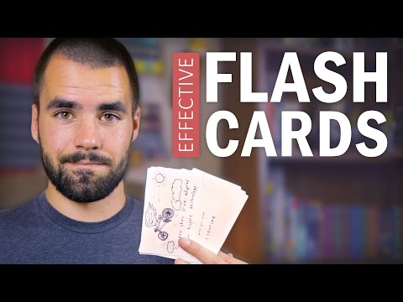
How to Use Flashcards Effectively
Watch from the start up until 5:53 minutes
Notes:
Impact of learning of teaching
Report back to students

Slide 24
Using Flashcards
Using flashcards is a repetition strategy
They are a simple ‘cue’ on the front and an answer on the back
Flashcards engage ‘active recall
Notes:
Impact of learning of teaching
Report back to students

Slide 25
There are many reasons why flashcards can help you learn. Let’s explore
them….

Slide 26
Why do flashcards help you learn?
When you make and use flashcards, you take control of your own learning.
You have to decide what to put on each card, how often you're going to use them and then evaluate how well you know the information on each card.
By doing all these things, you are using ‘metacognitive processes’ which have been proven to enhance long-term learning.

Slide 27
Why flashcards help you.
They help up to ‘recall information – this crates stronger connections for your memory
They promote self-reflection which ingrains knowledge into your memory.
Notes:
Impact of learning of teaching
Report back to students

Slide 28
How to make flashcards.
1. Ensure that the flashcards have a question or key term on one side and the answer or definition on the other.
- The flashcard must work the memory.
- If flashcards only contain notes then no retrieval practice will be happening.
Notes:
Impact of learning of teaching
Report back to students

Slide 29
How to make flashcards
2. Ensure the right questions and knowledge are on the cards.
3. Keep information as short as possible.
4. Write clearly. You should be able to read what you wrote at a very quick glance.
Notes:
Impact of learning of teaching
Report back to students

Slide 30
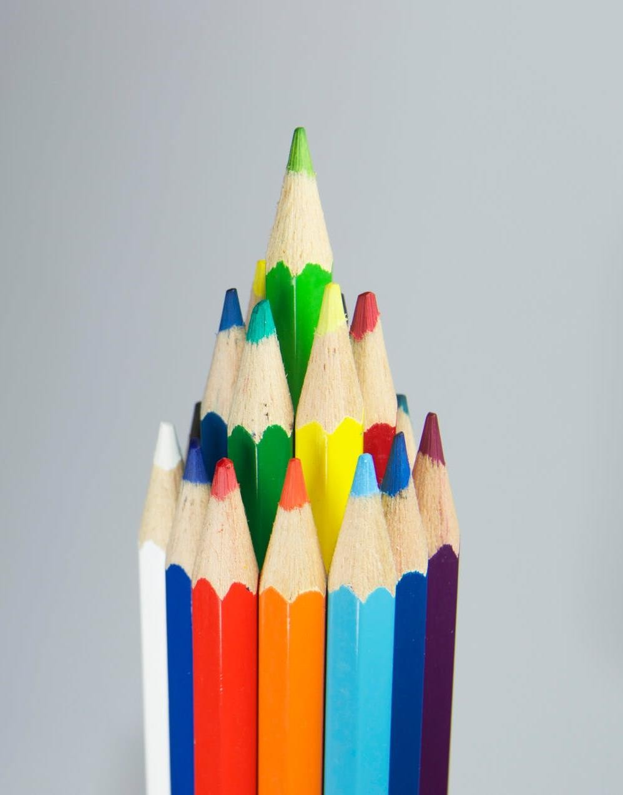
How to make flashcards
5. Use different coloured cards or pens to categorise your flashcards. For example, use a different colour for each subject or topic. This can help your brain to categorise information better.
6. Make your flashcards as soon as you've learnt the topic in class.
Notes:
Impact of learning of teaching
Report back to students

Slide 31
Being smart when using flashcards
Studies have found that it's more effective to review a whole stack of cards in one sitting rather than to carry them around with you and glance at them every so often.
Flashcards are not an effective method for last- minute cramming!
Notes:
Impact of learning of teaching
Report back to students

Slide 32
Being smart when using flashcards
Use spaced repetition - Review your cards at specific, increasing intervals: for example, on Day 1, Day 2, Day 4, Day 8 and so on.
Spaced repetition works because it activates your long- term memory, while leaving small breaks in-between studying uses your short-term memory.
Notes:
Impact of learning of teaching
Report back to students

Slide 33
Being smart when using flashcards
Try writing the answer or definition in your own words and giving examples. This will help your learning and recall.
Try ‘interleaving’. Once you have several decks of flashcards for different subjects and topics, try mixing them up. This will test your knowledge across subjects in a single session. Make sure you are confident enough to do this every so often.
Notes:
Impact of learning of teaching
Report back to students

Slide 34
Using a system to revise with flashcards
The Leitner system is a well-known and very effective method of using flashcards.
It's a form of spaced repetition that help you study the cards you don't know more often than the cards you already know well.
In the 1970s, a Geman populariser of science, Sebastian Leitner, developed the method
Notes:
Impact of learning of teaching
Report back to students

Slide 35
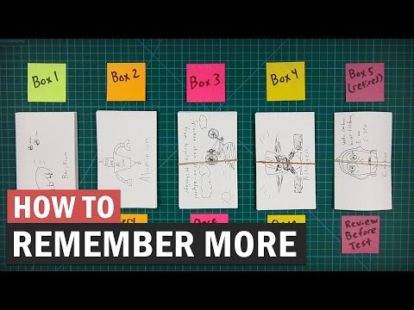
The Leitner System - start at 3:00 minutes (7:46 in total)
Notes:
Impact of learning of teaching
Report back to students

Slide 36
Notes:
Impact of learning of teaching
Report back to students

Slide 37
Leitner System – The Key
The key is that the cards you know less well are reviewed more frequently than the cards in the higher boxes
You now must choose the frequency at which you review each box
Box 1: Every day Box 2: Every 2 days
Box 3: Every 3 days
Box 4: Every 4 days
In the 1970s, a Geman populariser of science, Sebastian Leitner, developed the method
Notes:
Impact of learning of teaching
Report back to students

Slide 39
